Slide 1


Slide 2
Mission
Contribute to improving the health of our communities through leadership rooted in partnerships.
A Francophone establishment in which all populations are treated with respect for their culture and language.
Vision
To focus on the person...for healthy communities.
Values
Listen to appreciate diversity.
Learn through dialogue and reflection.
Guide with courage and transparency.
Support our patients through empathy and kindness.

Slide 3
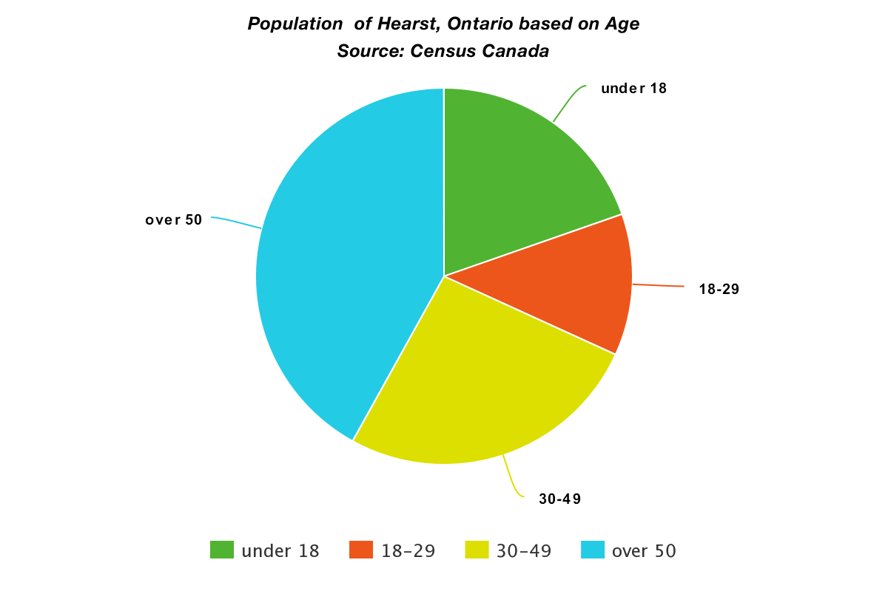

Slide 4
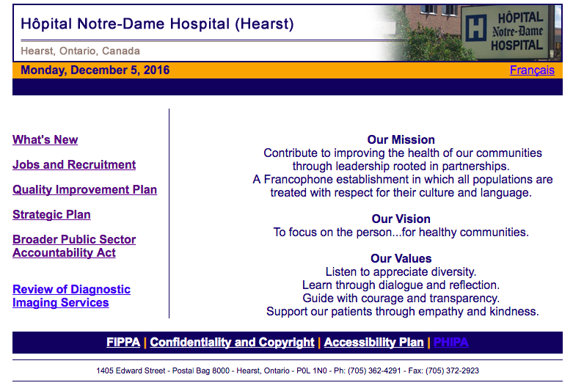

Slide 5
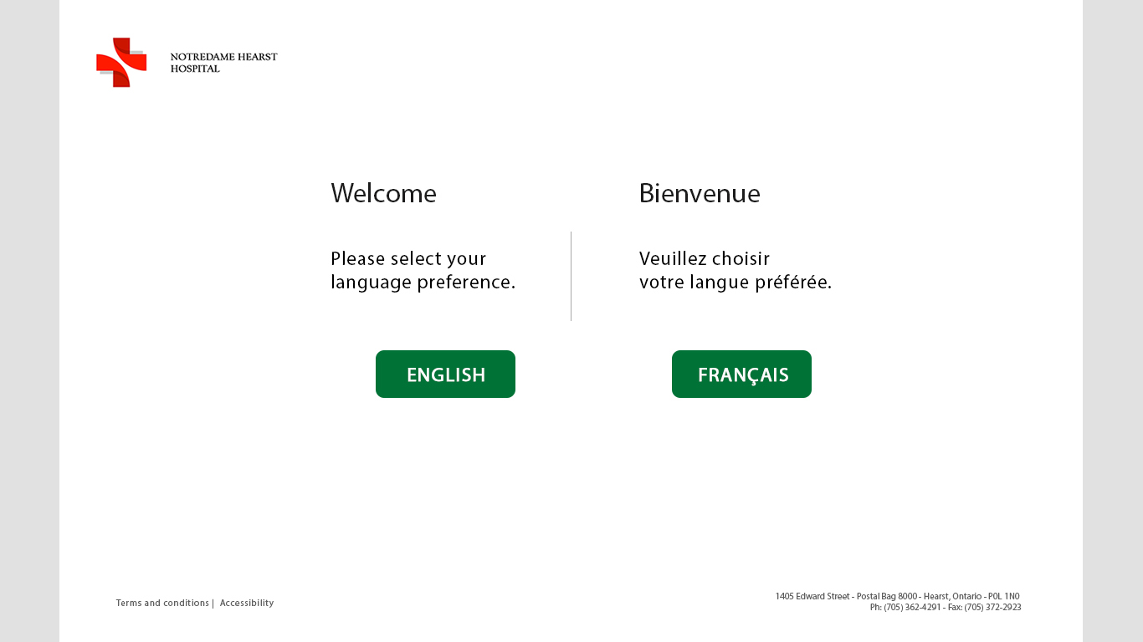

Slide 6
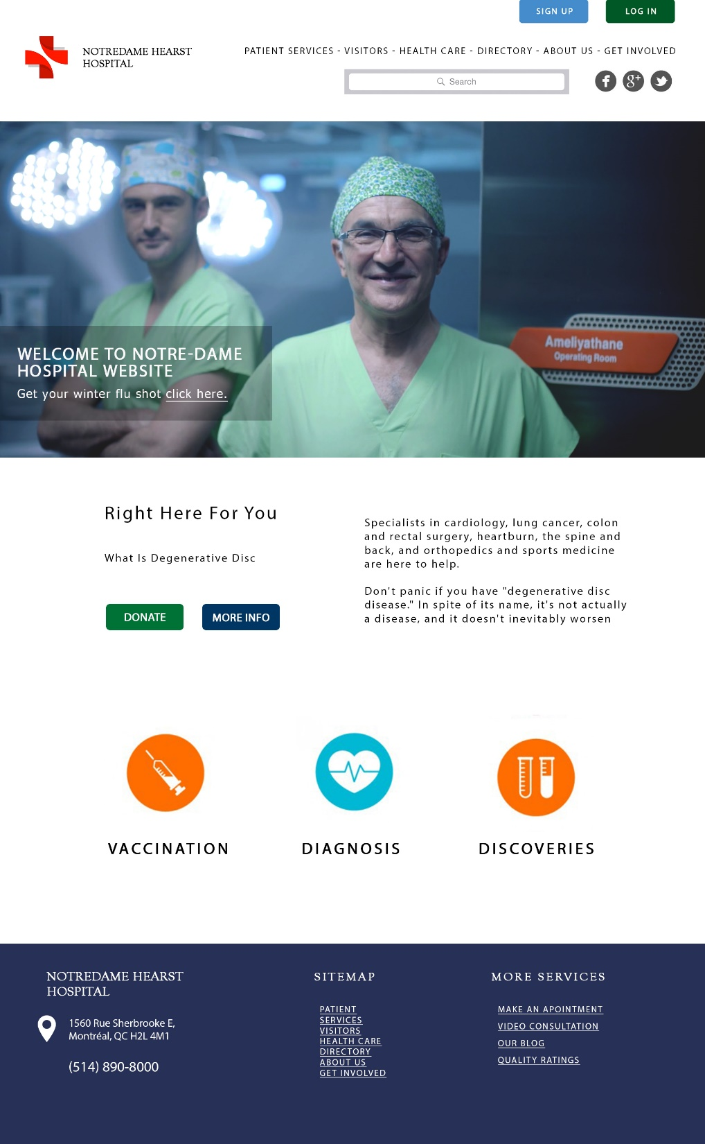

Slide 7


Slide 8
UI/UX Design
Visual design, User research, Content strategy

Slide 9
Understanding user needs
Look & Feel
Clear Navigation
User Flow

Slide 10
Objective
Design a product that eases & helps users to find out
The information they’re looking for from a hospital

Slide 16
HOSPITAL FEATURES

Slide 17

VIDEO CONSULTATION
Benefits
Minimize patient travel.
Reduce patient stress.
Encourages patient selfcare

Slide 18

RANKING SYSTEM
Benefits
Patient feedback.
Improved patients services.
Positive perception in the community.

Slide 19
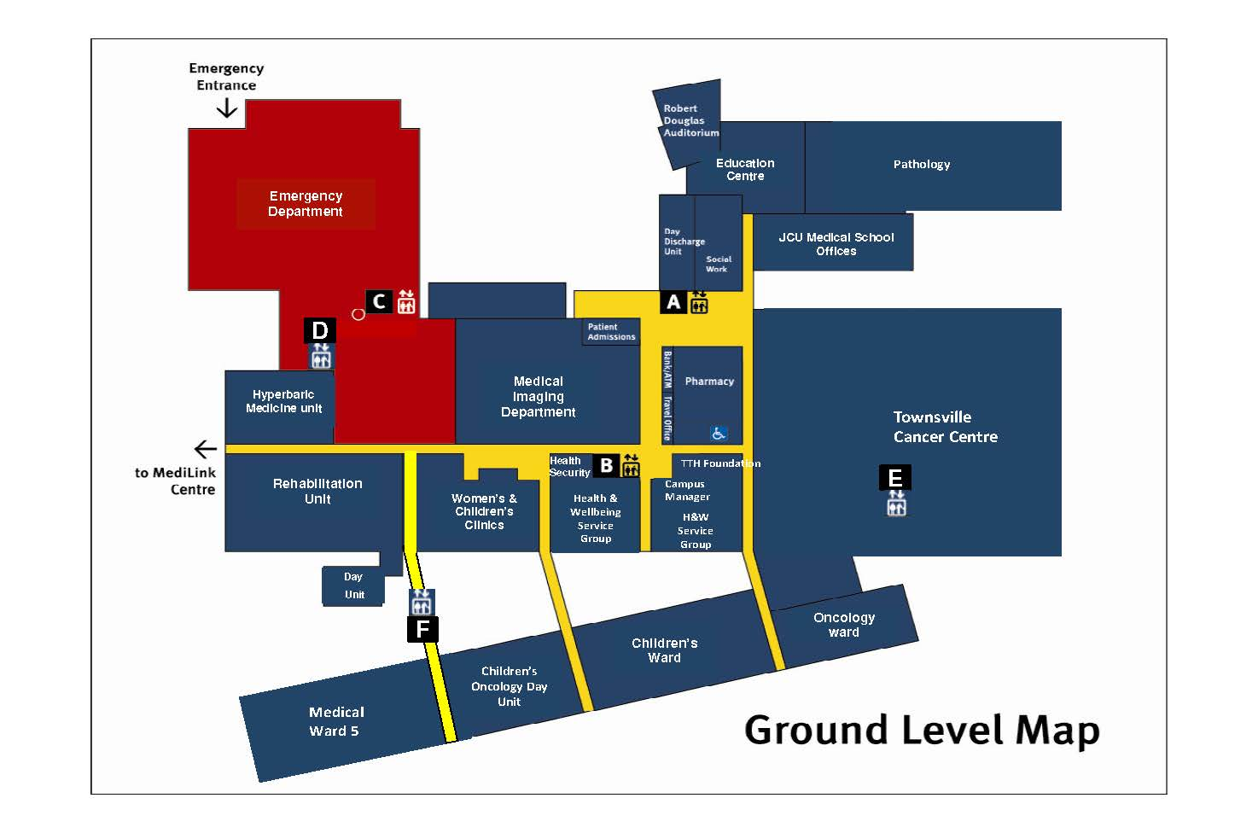
HOSPITAL MAP
Benefits
Informs first time visitors.
Saves time.

Slide 20

The power of the Web is in its universality. Access by everyone regardless of disability is an essential aspect.
Why Need to Care About Accessibility

Slide 21
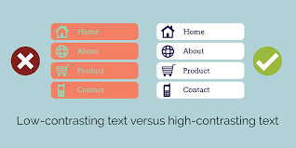
Barriers to Access
Visual Disabilities
Hearing Disabilities
Mobility Disabilities

Slide 22
Techniques for Developing Accessible Web Pages
Colors
Images and animations
Multimedia
Hypertext links
Page organization
Scripts, applets & plug-ins

Slide 23

Accessibility Features of Popular Browsers

Slide 24
Documents
World Wide Web Consortium (W3C).
Web Content Accessibility Guidelines.

Slide 25
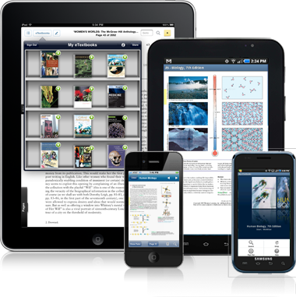
Responsive Web Design
Means that a web site works optimally well for users regardless of the device they are using.

Slide 26
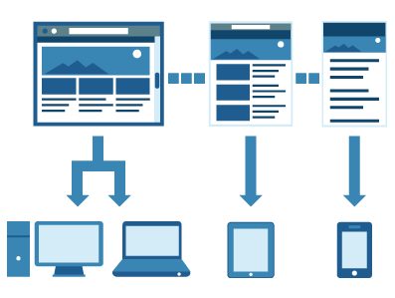
Why is it relevant
1/3 of the global internet users access the internet only via mobile

Slide 27
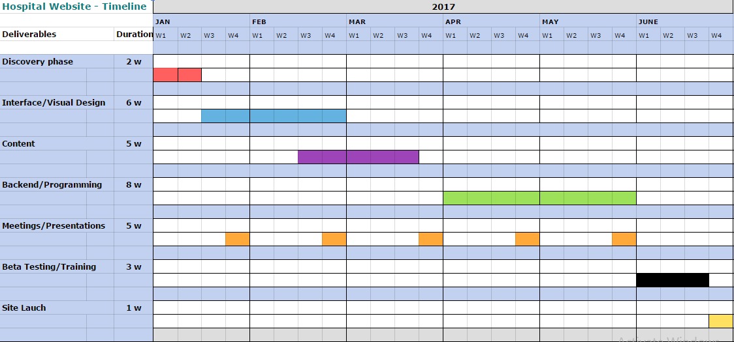
Timeline

Slide 28
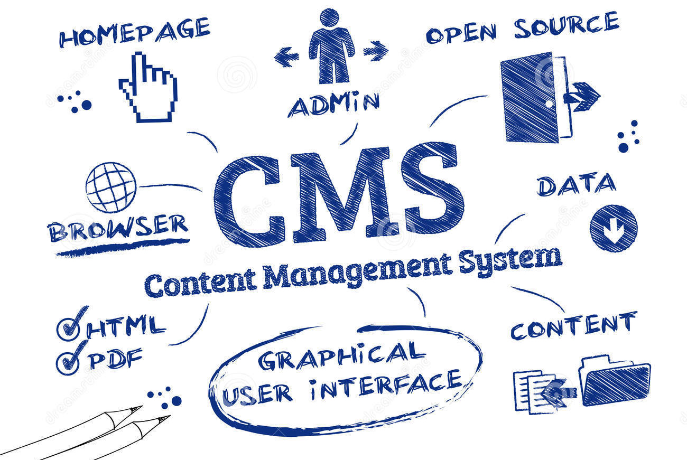
What is CMS

Slide 29
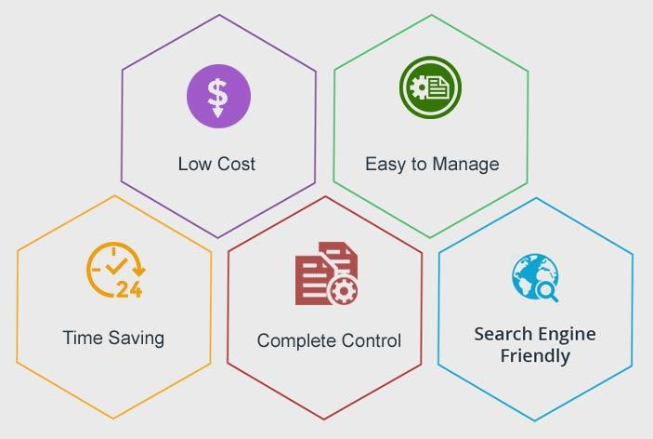
Why CMS

Slide 30
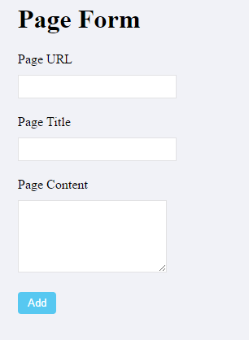
CMS example

Slide 31

Database

Slide 32
We will build a database best suited for your need, and optimized for performance.
Possible features for database:
Patients’ appointments;
Donors information;
Volunteer information

Slide 33

Data driven website
Database is at the center of the website:
Customers can see their appointments at home or on their phone.
Staff members can access it easily, make changes easily.
The administration can see what is going on with the day to day operation of the hospital.

Slide 34

Data allows you do more
We can build a donor database. Everyone who donated though the website will leave their information in the database. The administration can use the information to understand donors behavior and attract more donations.

Slide 35

Even community engagement
We can also build a volunteer database. You can reach to all of your volunteers with emails, informing them about upcoming volunteering opportunities, getting feed back or showing appreciation.

Slide 36


Slide 37
Thank you!

